Slide 1
Climate vs. Nihilism
W. Russ Payne
Chair, Philosophy
Bellevue College

Slide 2
If guilt moves you, more power to you.
That’s just not what this talk is about.

Slide 3
Origins of this talk

Slide 4
Origins of this talk
While we are here, let’s acknowledge with gratitude our presence on the traditional land of the Duwamish.

Slide 5
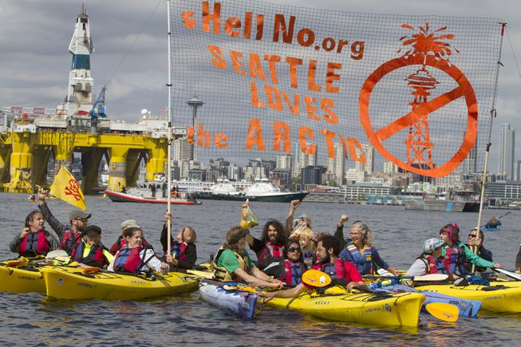

Slide 7
So what is Nihlism?
The standard view: Nihilism is the view that nothing matters. Life is meaningless and absurd.

Slide 8
So here’s what nihilists look like

Slide 9
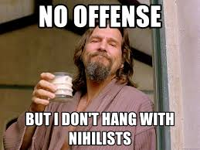

Slide 10
Nihilism, the condition
Nietzsche isn’t concerned about people adopting nihilism as a view, but rather with people suffering nihilism as a condition.

Slide 11
The earth has become small, and on it hops the last man, who makes everything small. His race is as ineradicable as the flea-beetle; the last man lives longest. ‘We have invented happiness,’ say the last men, and they blink. . . . . Who still wants to rule? Who obey? Both require too much exertion. No shepherd and one herd! Everybody wants the same, everybody is the same: whoever feels differently goes into the madhouse ‘Formerly all the world was mad’, say the most refined, and they blink. . . . ‘We have invented happiness,’ say the last men, and they blink.
Nietzche from Thus Sprach Zarathustra

Slide 12
Nietzsche sees the condition of nihilism as the absence of higher values. Nietzsche’s last man hasn’t rejected value all together. He still values his happiness, his comfort, complacency and convenience. What the last man lacks are higher values. These are values that place demands on us, give us purpose, inspire our passions and orient our communities.

Slide 13
“God is dead and we have killed him.”
Nietzche is a naturalist. That is he rejects any transcendent supernatural source of value.
His greatest anxiety, given the absence of transcendent value, is that we will become people concerned with nothing larger than our own personal selves. This is the condition of nihilism.
Nietsche’s way of addressing this absence of transcendent higher value is to take great feats of human creativity to be a remaining source of higher value.

Slide 14
Nietzsche was a bit of an elitist.
Nietzsche is a great admirer of human excellence. He rejects the egalitarian morality of Kant and Christianity as a slave morality. In his view it is perfectly appropriate for the interests of the average to be subordinated to the ambitions of the Ubermensche or overman.

Slide 15
Three Options for Meaning in Life:
Meaning in life has a transcendent source (God’s plan for us, or maybe the universe cares about us, or 42)
Nihilism. Life is meaningless.
We are the meaning makers

Slide 16
Against (1), Transcendent higher values, consider the case where the universe does care, but in a way you find abhorrent. Or suppose God’s plan for you is to be a deluded fool. These scenarios couldn’t give meaning to life.

Slide 17
As for (3), well, (obviously) it wouldn’t matter if Nihilism were true. But, nihlism kind of sucks, so it would be nice if we can avoid ending up on this square.

Slide 18
“Nihilism sucks” is not really an argument against nihilism being true.
Unless caring that nihilism is false means that something matters.
In which case something matters and so nihilism is false.

Slide 19
Meaning in Life: Irving Singer’s Naturalistic Approach
When something matters to us, it matters period.
We are the sources of value in the world.
We give meaning to life by loving the good in everything

Slide 20
So I care about having nice car and a successful career. Doesn’t that add meaning to my life?
On Singer’s view, yes, just not very much. Scope matters for leading a meaningful life. Limiting our concern to personal self interest makes for a rather cramped sense of meaning and purpose. And again, what meaning we find in personal selfish interests is ultimately vulnerable to eventual, inevitable decay and loss.

Slide 21
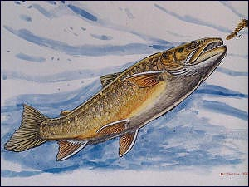
As a form of life I can identify in specific ways with all other forms of life. Like me, all life forms seek a good of their own. Even when I pluck a fish from a river and obliterate its vital force to feed my own, I can’t help but regard that vitality as a good thing. Irving Singer likens this vital force, this seeking a good of one’s own, to Spinoza’s conatus and Nietzsche’s will to power and deems it a source of meaning in life. Vitality is not the only or even the most fundamental source of meaning in life on Singer’s view. But it is a source of meaning that inexorably binds us to the rest of life on this planet.

Slide 22
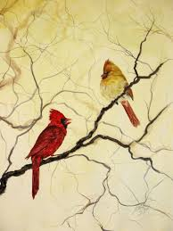
How can you not love what you identify with?
Only by failing to love yourself.

Slide 23
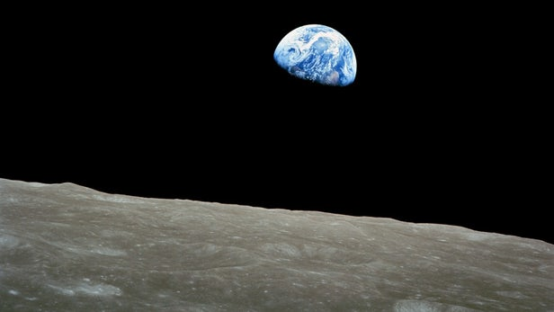
So, why should you care about Climate Change?
In order to lead a more meaningful purposeful life.

Slide 24
George Bernard Shaw
This is the true joy in life, the being used for a purpose recognized by yourself as a mighty one; the being thoroughly worn out before you are thrown on the scrap heap; the being a force of Nature instead of a feverish selfish little clod of ailments and grievances complaining that the world will not devote itself to making you happy.

